Slide 1
Precision Agriculture
Week 6

Slide 2
Model
We will compare model fitness obtained from using Tensorflow and Keras libraries using their loss and accuracy graphs.
The models implemented are:
MobileNet (V1, V2, V3), with 3 input sizes for each version and different width multiplier.
AlexNet, with 3 input sizes.
?
The model were imposed to classify from 12 classes, which are:
['Apple___Apple_scab', 'Apple___Black_rot', 'Apple___Cedar_apple_rust', 'Apple___healthy', 'Corn_(maize)___Cercospora_leaf_spot Gray_leaf_spot', 'Corn_(maize)___Common_rust_', 'Corn_(maize)___Northern_Leaf_Blight', 'Corn_(maize)___healthy', 'Tomato___Early_blight', 'Tomato___Tomato_Yellow_Leaf_Curl_Virus', 'Tomato___Tomato_mosaic_virus', 'Tomato___healthy']

Slide 3
Dataset
Data augmentation was used on training set to introduce more variance.
shear_range=0.2,
zoom_range=0.2,
rotation_range=90,
width_shift_range=0.2,
height_shift_range=0.2,
horizontal_flip=True

Slide 4
Training Notes
Using Transfer learning the training took approx. half the training time. (Faster training)
This quicker accuracy achievement by the transfer learning model will prove very useful when comparing between TL vs Normal.
Early Stopping

Slide 5
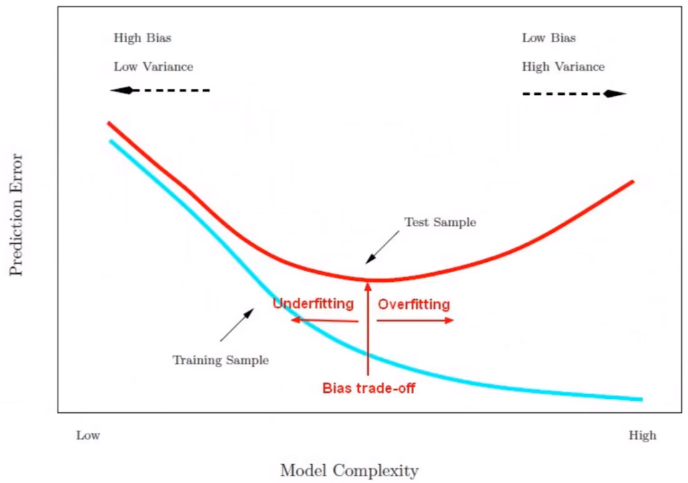
Fitness

Slide 6
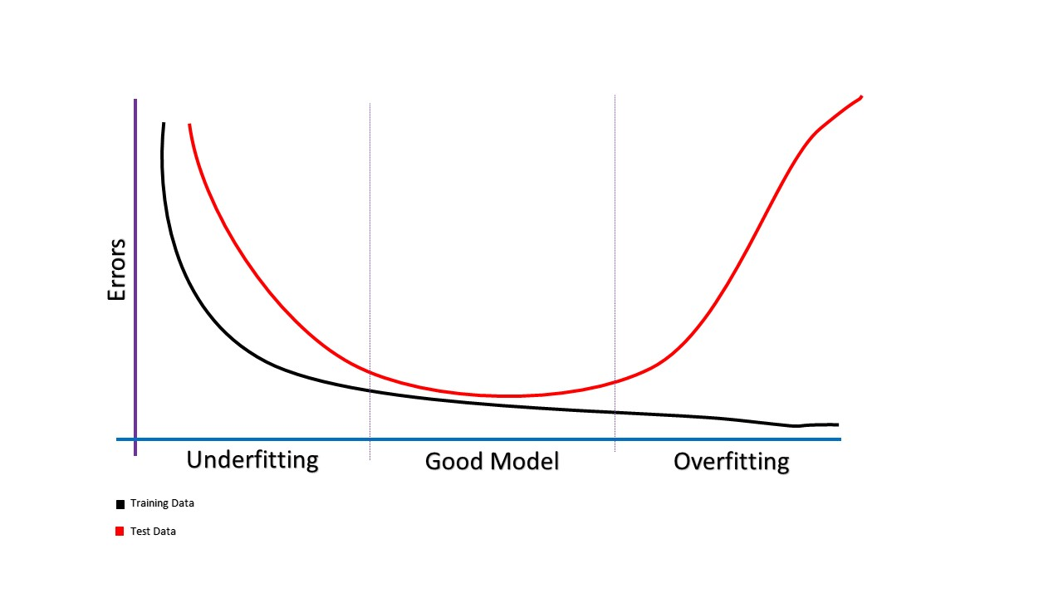

Slide 7
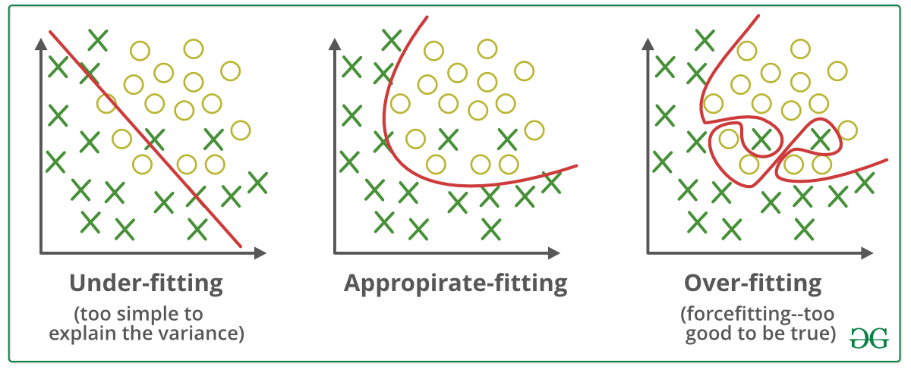
Graphs

Slide 8
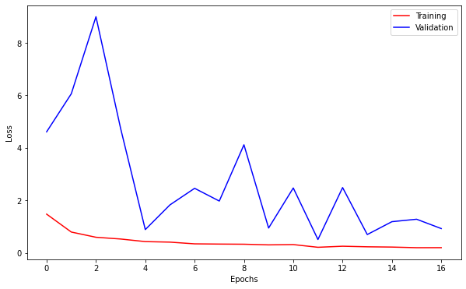
MobileNet V1
When trained over never before seen images this model scored poorly, with 0.9 loss and 0.7 accuracy.
Studying the graph we can understand that the model was underfit due to the relatively small dataset.
If every epoch the model had a larger diversity of data points the validation loss would be much more stable.
Moreover, if the number of epochs were increased, the model would reach a much better fitting if not overfit.

Slide 9
Evaluation

Slide 10
Weight Trimming

Slide 11
Quantization

Slide 12
Challenges

Slide 13
Project Future Plan
In order to make an educated decision on a feasible plan going forward; we reviewed papers regarding the topics of implementing CNNs on FPGAs using the 4 following techniques:
OpenCL
Raw SoC
Nios
RTL
On top of that, we aim to achieve a full functional simulation implementation of MobileNet V1 using Python’s basic libraries in order to concretely understand the low level workings of our model.
Lastly, with these two data points; we can make the precise decision based on the feasibility of reviewed results and confidence from the functional simulation, on which of the 4 techniques to follow through with.

Slide 14
Structure
Review OpenCL vs Raw vs Nios vs RTL (preferably papers using DE10/DE0 when applicable).
Achieve functional simulation by Python implementation.
Evaluate results of review and make educated decision going forward based on functional simulation confidence and review results.
Low level review of chosen path.

Slide 15
OpenCL & Raw (SoC-FPGA)
OpenCL and Raw implementation require their host-accelerator architecture to be deployed on different devices.
Main program execution occurs on the SoC(host program) where only highly parallel functions are offloaded to the FPGA(accelerated function).
The use of an interface between SoC and FPGA is required (Bitstream/Memory mapping).
This will introduce high I/O latency. [Ammar]
FPGA
SoC
FPGA
SoC
Interface
VHDL
OpenCL (OpenCL C)
Compute Kernels
Raw (C/Python)
Host
Accelerated Function
Host
Accel. Func

Slide 16
Vivado
FPGA
Board
AXI Mem. Map
VHDL (C/C++ Vivado HLS)
DDR3 Memory
Accel. Func
AXI Interface

Slide 17
OpenCL
SoC
FPGA
OpenCL C
Compute Kernels
Host
Accel.
Function

Slide 18
Raw Implementation
FPGA
SoC
Interface
VHDL
Raw (C/Python)
Host
Accel. Func

Slide 19
Nios (SoPC)
Similar to what was discussed on the previous slide; Nios pertains the same host-accelerator architecture, yet all the execution occurs on the FPGA fabric.
The same interface to what is used on SoC-FPGA is also used here to allow for communication. However, the interfacing is relayed on the same device.
This allows for reduced I/O latency compared to SoC-FPGA, while introducing increased memory utilization on internal FPGA memory.
VHDL
FPGA
Host
Interface
Accel.

Slide 20
General
Metric | OpenCL | Raw SoC | Vivado | RTL
Host lang | OpenCL C | C/Python | C/C++ | VHDL
Accel. lang | Compute Kernel | VHDL | C/C++ | VHDL
Host interface | SDK/DMA | Avalon/AXI/ DMA | Avalon/AXI/ DMA | DMA/Not required depending on model size

Slide 21
Utilization
Metric | OpenCL [6] | Vivado [7] | RTL [8]
Device | DE5-Net | xczu9eg-ffvb1156-2-i | Virtex VC709
ALUT/ALMs | 49% | 11% | 66%
FF | - | 6% | 31%
BRAM | 74% | 5% | 68%
DSP | 100% | 5% | 57%

Slide 22
Performance
Metric | OpenCL [6] | Vivado [7] | RTL [8]
Device | DE5-Net | xczu9eg-ffvb1156-2-i | Virtex VC709
Precision | 8 bit | 11 bit | 16 bit
# Op. per Image | 1.46 GOP | 410,758 Cycles | 611.52 GOP
Inference Time (Approx.) | 45.7 ms | 3.58 ms | 2.41 ms

Slide 23
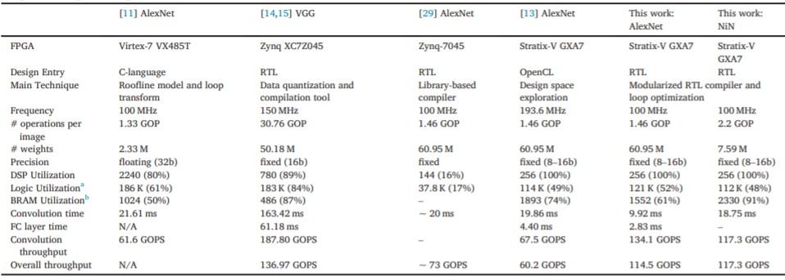
RTL

Slide 24
Initial Review Conclusions
It was prevalent that researchers used Vivado HLS to dynamically create synthsiable code by writing host C/C++ and including meta statements in the code to contrast functions that should run in parallel.
Papers [1], [2] and [3] use Vivado HLS extensively to load RTL code onto FPGAs.
Papers [1], [2] and [3] use Vivado HLS in order to contrast their own RTL implementations.
If Xilinx device is available through university/fund it would prove a powerful reference going forward.
Lastly, it is important to consider that our available models are noticeably smaller than previous implementations. Which opens doors to ROM based full SoPC implementations.
Notes:
Zynq python
Zybo z20
Pynq

Slide 25
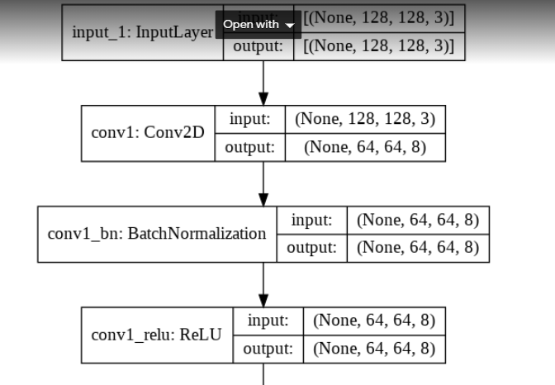
Python Functions
Next step: is doing mobilenet cnn model using python, This four main components that we are going to implement it.

Slide 26
Evaluation
yo

Slide 27
Low Level Review

Slide 28
Challenges

